Slide 1
Project 1
The Grammy’s: Are they Rigged?
Luz Aguilar Sanchez, David Bartlett, Jai’Lyn Jones, Scott McNiff

Slide 2
Introduction
The first Grammy event was held in 1959 at two locations simultaneously: Beverly Hills, California and New York City, New York
28 Grammys were awarded
The number of awards since then has fluctuated, at one point reaching over 100
The second Grammy event was the first televised ceremony, but was not aired live until the 13th awards in 1971
Most of the awards are genre specific, with only 4 encompassing all
genres and musical types: Best new artist, Song of the Year, Album of the Year, and Record of the Year
Only 2 artists have ever won all 4: Christopher Cross, and Adele
The even has drawn criticism over whether winners are truly deserving of the awards or there are other outside factors

Slide 3
Questions For Analysis
The aim of our project is to uncover patterns in Grammy Award winners from 2010 to 2019 in two categories: Record of the Year and Album of the Year. We’ll examine relationships between Record of the Year award winners and song attributes, Album of the Year award winners and Album ratings, and other related relationships derived from the data.
Questions we will be looking to answer:
Is there a trend with the genres of the artists and songs that win?
What kind of attributes do the record of the year winning songs have?
How many artists performed at the Grammys ended up winning an award that year?
Which genre was the most popular throughout the decade?
Is there a correlation between Record of the year and Album of the year, and did any artist win both awards in the same year?

Slide 4
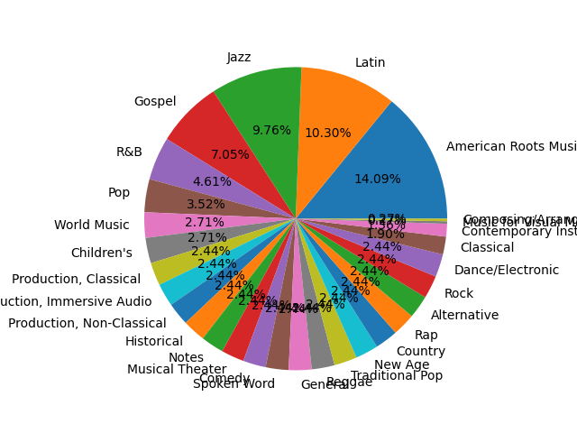
Pie Chart: Overall Grammy Winners By Genre
Notes:
# Due to overlap with multiple Award categories "American Roots Music" is the highest nominated genre, next to Latin and Jazz.

Slide 5
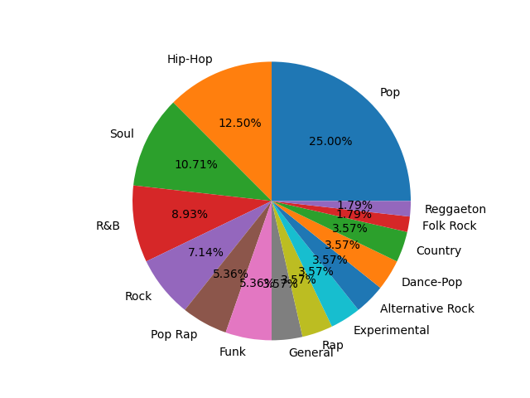
Pie Chart: Record of the Year Winners by Genre
Notes:
# The 25% of the Record of the Year Nominees and Winners from 2010-2019 are Pop records, with Hip-Hop, Soul , and R&B following while the other <50% consist of the other genres.

Slide 6
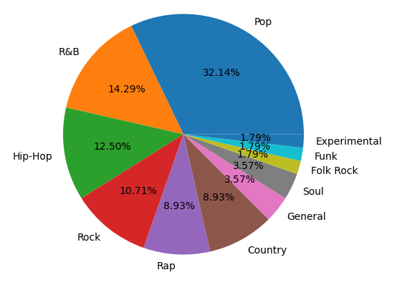
Pie Chart: Album Of the Year Winners By Genre
Notes:
# Album of the Year Winners and Nominees consist largely almost one third of Pop Albums, collectively R&B, Hip-Hop, and Rock take another third of the genres

Slide 7
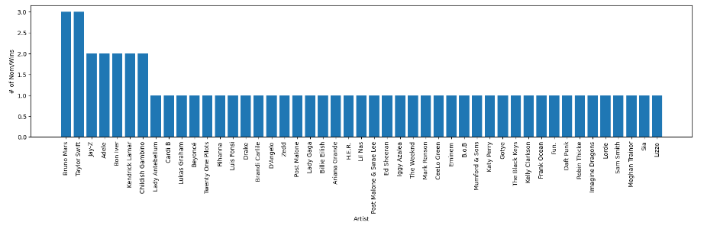
Bar Chart: Record of the Year Overall Nominations/Wins By Artist for 2010-2019
Notes:
# In ten years Bruno Mars and Taylor Swift each were nominated for or won 3 Awards.

Slide 8
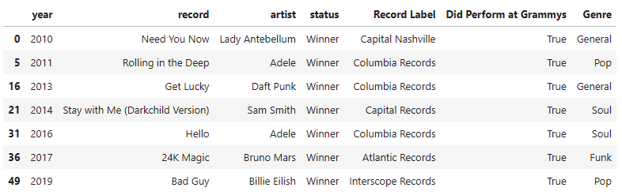
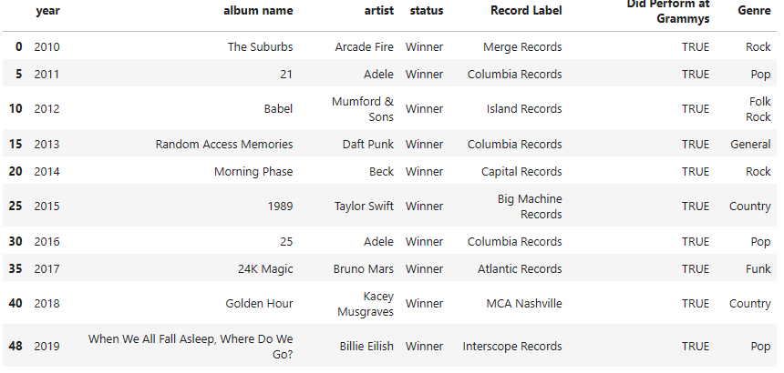
DataFrame: Record of the Year Nominees Who Won and Performed at Grammys that year
Notes:
# 70% of Record of the Year winners in the last ten years performed at the Grammy's.
# 100% of Album of the Year winners from 2010-2019 performed at the Grammy's.
# In 2011, 2013, 2016, 2017, and 2019 one artist won both awards (50%).
# Coulmbia Records produced the most winning Albums of the Year and Records of the Year.

Slide 9
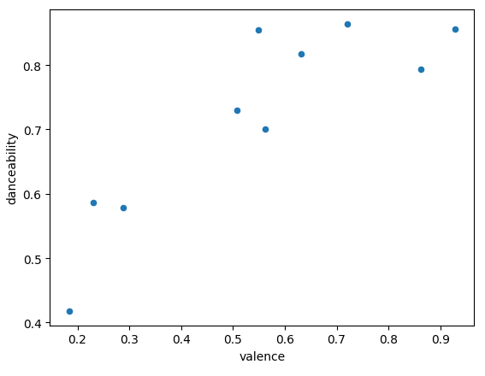
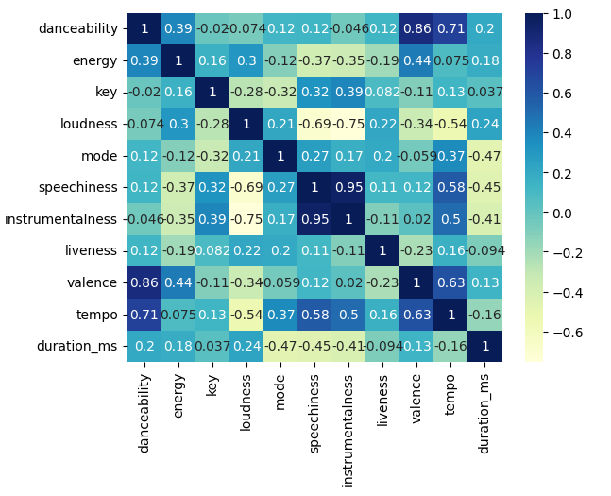
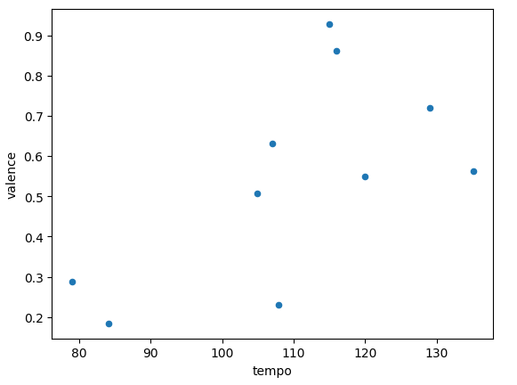
Correlation Matrix & Dot Plots: Key Song Feature Relationships
Notes:
# instrumentalness and speechiness, valence and danceability, tempo and danceability, valence and tempo
# All of these have a high correlation meaning they have a positive relationship i.e. songs with higher ‘danceability’ tend to have more ‘valence’

Slide 10
ROTY Analysis
Twenty five percent of Nominees and Winners for this award were Pop songs. Seventy percent of Record of the Year winners performed at the Grammys. Fifty percent of winners also won Album of the Year from 2010 - 2019.

Slide 11
AOTY Analysis
Within the same time frame roughly one third of the nominees and winners of this award are Pop albums and 100% of Album of the Year winners performed at the award show. In 2011, 2013, 2016, 2017, and 2019 the artist who won this award also won Record of the Year.

Slide 12
Conclusion
Here we can definitely see a trend and this alludes to the possibility that the winners are chosen to perform before they are announced meaning the next time the Grammy performers are announced there is a high chance that they may win Album of the Year or Record of the Year if they are nominated. The albums that tend to win are Pop. The records that tend to win are also mostly Pop, and have high key features such as tempo, danceability and instrumentalness.

Slide 13
THANK YOU!

Slide 14
Sources
https://marianaossilva.github.io/DSW2019/#tables
https://www.kaggle.com/datasets/danield2255/data-on-songs-from-billboard-19992019
https://en.wikipedia.org/wiki/List_of_Billboard_200_number-one_albums_of_2017
https://www.grammy.com/awards/rules-guidelines
https://www.kaggle.com/datasets/unanimad/grammy-awards
https://www.kaggle.com/datasets/skylarjohnson/grammy-winners-from-2009-2019
https://www.kaggle.com/code/rajnaruka0698/the-grammy-arwards-analysis

